Slide 1
Manual Testing

Slide 2
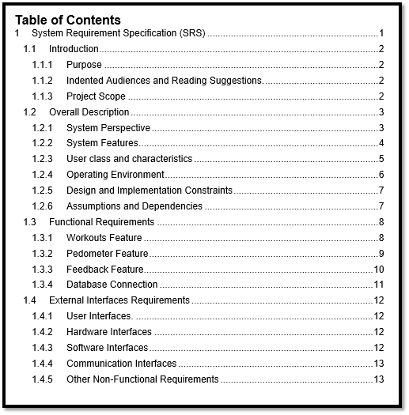

Slide 3
Test Planning
Importance
Re-Planning
Types of Plans
RACI
What is high level plan, low, level plan

Slide 4
Test planning
A Test Plan is a critical and exhaustive document that outlines the strategies, goals, timeline, estimations, deadlines, and resources needed for the successful completion of a project. It provides a framework that is designed by QA managers to provide clarity about the necessary tests that you need to verify to ensure the proper functioning of the software.

Slide 5
Importance
Objectives of the Test Plan:
Overview of testing activities: The test plan provides an overview of the testing activities and where to start and stop the work.
Provides timeline: The test plan helps to create the timeline for the testing activities based on the number of hours and the workers needed.
Helps to estimate resources: The test plan helps to create an estimate of the number of resources needed to finish the work.
Serves as a blueprint: The test plan serves as a blueprint for all the testing activities, it has every detail from beginning to end.
Helps to identify solutions: A test plan helps the team members They consider the project’s challenges and identify the solutions.
Serves as a rulebook: The test plan serves as a rulebook for following rules when the project is completed phase by phase.

Slide 6
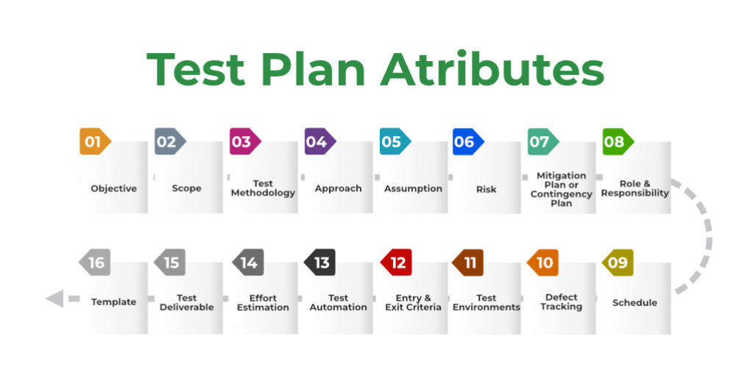

Slide 7
1. Objective: It describes the aim of the test plan, whatever the good process and procedure they are going to follow to give quality software to customers. The overall objective of the test is to find as many defects as possible and to make software bug-free. The test objective must be broken into components and sub-components. In every component following activities should be performed.
List all the functionality and performance to be tested.
Make goals and targets based on the application feature.
2. Scope: It consists of information that needs to be tested concerning an application. The scope can be divided into two parts:
In-Scope: The modules that are to be tested rigorously.
Out Scope: The modules that are not to be tested rigorously.
Example: In an application A, B, C, and D features have to be developed, but the B feature has already been designed by other companies. So the development team will purchase B from that company and perform only integrated testing with A, B, and C.
3. Testing Methodology: The methods that are going to be used for testing depend on application to application. The testing methodology is decided based on the feature and application requirements.
Since the testing terms are not standard, one should define what kind of testing will be used in the testing methodology. So that everyone can understand it.
4. Approach: The approach of testing different software is different. It deals with the flow of applications for future reference. It has two aspects:
High-Level Scenarios: For testing critical features high-level scenarios are written. For Example, login to a website, and book from a website.
The Flow Graph: It is used when one wants to make benefits such as converging and merging easy.

Slide 8
5. Assumption: In this phase, certain assumptions will be made.
Example:
The testing team will get proper support from the development team.
The tester will get proper knowledge transfer from the development team.
Proper resource allocation will be given by the company to the testing department.
6. Risk: All the risks that can happen if the assumption is broken. For Example, in the case of wrong budget estimation, the cost may overrun. Some reason that may lead to risk is:
Test Manager has poor management skills.
Hard to complete the project on time.
Lack of cooperation.
7. Mitigation Plan: If any risk is involved then the company must have a backup plan, the purpose is to avoid errors. Some points to resolve/avoid risk:
Test priority is to be set for each test activity.
Managers should have leadership skills.
Training course for the testers.

Slide 9
8. Roles and Responsibilities: All the responsibilities and role of every member of a particular testing team has to be recorded.
Example:
Test Manager: Manages the project, takes appropriate resources, and gives project direction.
Tester: Identify the testing technique, verify the test approach, and save project costs.
9. Schedule: Under this, it will record the start and end date of every testing-related activity. For Example, writing the test case date and ending the test case date.
10. Defect Tracking: It is an important process in software engineering as lots of issue arises when you develop a critical system for business. If there is any defect found while testing that defect must be given to the developer team. There are the following methods for the process of defect tracking:
Information Capture: In this, we take basic information to begin the process.
Prioritize: The task is prioritized based on severity and importance.
Communication: Communication between the identifier of the bug and the fixer of the bug.
Environment: Test the application based on hardware and software.
Example: The bug can be identified using bug-tracking tools such as Jira, Mantis, and Trac.
11. Test Environments: It is the environment that the testing team will use i.e. the list of hardware and software, while testing the application, the things that are said to be tested will be written under this section. The installation of software is also checked under this.
Example:
Software configuration on different operating systems, such as Windows, Linux, Mac, etc.
Hardware Configuration depends on RAM, ROM, etc.

Slide 10
12. Entry and Exit Criteria: The set of conditions that should be met to start any new type of testing or to end any kind of testing.
Entry Condition:
Necessary resources must be ready.
The application must be prepared.
Test data should be ready.
Exit Condition:
There should not be any major bugs.
Most test cases should be passed.
When all test cases are executed.
Example: If the team member reports that 45% of the test cases failed, then testing will be suspended until the developer team fixes all defects.

Slide 11
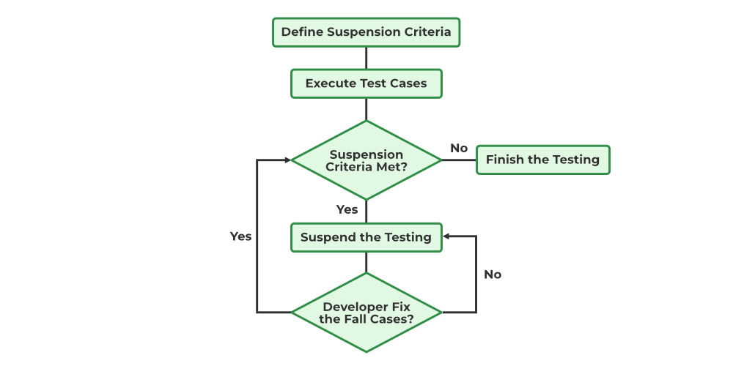

Slide 12
13. Test Automation: It consists of the features that are to be automated and which features are not to be automated.
If the feature has lots of bugs then it is categorized as Manual Testing.
If the feature is frequently tested then it can be automated.
14. Effort Estimation: This involves planning the effort that needs to be applied by every team member.
15. Test Deliverables: It is the outcome from the testing team that is to be given to the customers at the end of the project.
Before the testing phase:
Test plan document.
Test case document.
Test design specification.
During the testing phase:
Test scripts.
Test data.
Error logs.
After the testing phase:
Test Reports.
Defect Report.
Installation Report.
It contains a test plan, defect report, automation report, assumption report, tools, and other components that have been used for developing and maintaining the testing effort.

Slide 13
16. Template: This is followed by every kind of report that is going to be prepared by the testing team. All the test engineers will only use these templates in the project to maintain the consistency of the product.

Slide 14
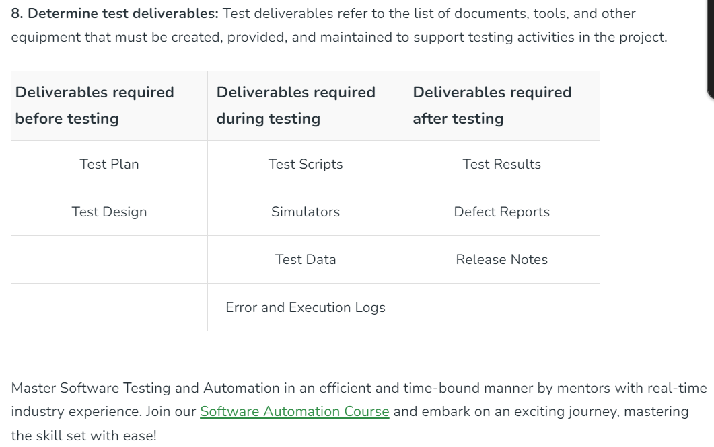

Slide 15
Test Replanning
Replanning of test plan signifies that test plan must undergo constant updation at every phase of development period example change in client requirements leads to the changes in release cycle and hence affects testing cycle as well.

Slide 16
Types of test plans
Master Test Plan: In this type of test plan, includes multiple test strategies and has multiple levels of testing. It goes into great depth on the planning and management of testing at the various test levels and thus provides a bird’s eye view of the important decisions made, tactics used, etc. It includes a list of tests that must be executed, test coverage, the connection between various test levels, etc.
Phase Test Plan: In this type of test plan, emphasis is on any one phase of testing. It includes further information on the levels listed in the master testing plan. Information like testing schedules, benchmarks, activities, templates, and other information that is not included in the master test plan is included in the phase test plan.
Specific Test Plan: This type of test plan, is designed for specific types of testing especially non-functional testing for example plans for conducting performance tests or security tests.

Slide 17
High level plan vs low level plan
Low level plan aims at delivery test at the sprint level.
High level plan is designed before the testing period starts.
As we go from higher level to lower level, test plans becomes more of test strategy

Slide 18
Elements of the Test Environment
Each test environment or QA Environment is set up with a combination of the following elements:
The software to be tested
The operating system, database, and testing server
Test data
Network configuration
The device on which the software is to be tested – desktop or mobile devices
Test automation framework and relevant tools such as Selenium or Cypress
Appropriate documentation – test scenarios, user manuals, business & customer requirements
Software to interface between system and applications

Slide 19
We typically have four environments along any software's lifecycle.
Development
Testing
Staging
Production

Slide 20
Development environment
The development environment is the location of the main branch of a software application. This is where developers spend time writing the first lines of code. From here, an application transforms from concept (on paper) into the MVP (minimum viable product).
Recently, the development stage has been overtaken by version control systems: GitHub and its competitors. They essentially host code in public and private repositories in the cloud. This makes this environment the easiest to set up. With the GitHub case, the free tier has enough features and resources for the starting phase of most applications.

Slide 21
Testing environment
When you set aside an entire server (could be a container) to run tests uninterrupted, you’ll have created a test environment. Typically, a test environment meets the minimum requirements for your application to function.
Depending on your preferred testing tools and frameworks, you may need more than one test environment for each possible access instance. For example, Selenium tests can’t run for the entire selection of browsers you want your application accessible through at the same time. This means you either run tests one after another, or you create several test environments.

Slide 22
Staging environment
Going up from the test phase, we have the app staging environment. Staging is when you create an instance of an application that you're confident enough to show the immediate owner (sponsor) but not users. Before exposing to the latter group, you'd want to run more tests. A staging environment is meant to simulate production as much as possible.
The staging environment is often restricted to a few select people. Whitelisted emails, IPs, and your developer team are the only groups that can use the application in staging.
It’s worth noting that staging environments are no substitute for a real-world production environment. The surest way to know how new features will perform with real users is to test them in production. At LaunchDarkly, we’re big advocates of testing in production with feature flags.

Slide 23
Production environment
As an end-user, when you use a web or mobile application, the application is running on a production server. It has been produced. We mentioned how testing was necessary for every application, however, not every environment is a prerequisite.
Thanks to feature flags, many development teams are doing away with some staging environments altogether. The first visible benefit of such a move is cost savings. What it actually implies is that the production environment absorbs the other pre-production states.
Tests can be conducted during production, with new features being released safely at the same time. Feature flags make it possible to show a few specific users a future version of an application, while the rest enjoy its current version.

Slide 24
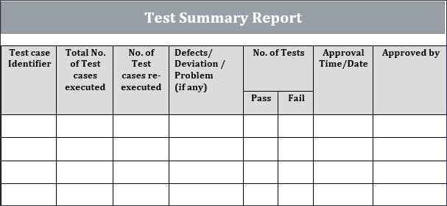

Slide 25
There are three basic types of test case reporting in software testing:
Test incident report
Test cycle report
Test summary report

Slide 26
1. Test Incident Report
This report communicates the defects or issues as they occur during the life cycle. Defect and issue management involve multiple people from various teams; for instance, the nature of the bug or issue may require the tester to get in touch with the developers, or there may be issues in deployment, or simply a technical flaw in the design and propagation. This is the stage where the report is generated regarding these issues and bugs to take the relevant teams on board.
The issues most often refer to bugs but that is not always the case. Any incident that may occur unexpectedly during the testing life cycle is reported in the Test Incident Report. The defects or incidents reported in this report are added to a repository with a unique ID for an easier inquiry into the issue. Here, the issues and incidents are categorized according to the priority as well. The high priority ones are highlighted for preferred redressal. It is advisable to add the persons assigned with the task in the incident report as well, for better management.
Besides the obvious objective of this report, which is to highlight all the bugs and issues, and hence, take consequent action, this process also cultivates transparency amongst the software teams and enhances correspondence between them. This atmosphere of transparency leads to lesser chances of miscommunication between the team members and other participants involved in the project.

Slide 27
2. Test Cycle Report
Test Cycle Report refers to running various tests in the testing life cycle. It includes the planning and execution of certain tests, the priority of those tests, and the severity of issues to be addressed. Test Cycle Report is generated for each cycle and a separate cycle is executed for each separate build of the product. The idea is to run multiple cycles on a product if needed, and to ensure that the product emerges stable and error-free at the end of the rigorous test cycles.
The Test Cycle Report ideally explains an overall situation of the cycle with the various defects that emerged during the cycle, their severity, and the impact those defects had on the overall product test cycle. It should also be able to bridge the previous cycles with the latest in an attempt to explain the flow of events. An important thing about a Test Cycle Report is that it entails the new defects and apprehends the issues that may arise as the product sets on to maturity. All of the issues that surfaced but were not addressed in the latest cycle are also included in the Test Cycle Report so that the redressal gets picked up right where the last cycle ended.
For example, in Kualitee’s dashboard, a quick glance at the below chart will give you readiness of each test cycle.

Slide 28
3. Test Summary Report
The test summary report is the crux of the test cycle that recommends that the product is mature and ready for release. It can be considered as the final word regarding the entire cycle, finishing it with a conclusive remark. It indicates how effectively the testing project was carried out
A test summary report can be generated at the end of each phase of the cycle separately, as well as at the end of the entire life cycle of the product. A phase-specific test summary report helps identify the targeted areas in the product life cycle for a referral. A conclusive test summary is a certificate of fitness for the product.
This type of report is usually prepared by the Test Manager. It should be crisp and to the point—with all necessary details included.
The test summary report should be able to explain the test items with their IDs, the variations that may have occurred during the cycle and how they were resolved, and a clear-cut summary of all the results including their assessment. It should distinctly mention that the product is fit for release along with a formal recommendation for product release.

Slide 29
Test cases that could be automated in airbnb

Slide 30
Test estimation
Test Estimation is a management activity which approximates how long a Task would take to complete. Estimating effort for the test is one of the major and important tasks in Test Management.

Slide 31
Step 1) Divide the whole project task into subtasks

Slide 32
Step 2) Allocate each task to team member
In this step, each task is assigned to the appropriate member in the project team. You can assigned task as follows
Task | Members
Analyze software requirement specification | All the members
Create the test specification | Tester/Test Analyst
Build up the test environment | Test Administrator
Execute the test cases | Tester, Test Administrator
Report defects | Tester

